Slide 1
Accelerator Design Patterns
Yoav Etsion

Slide 2
How do accelerators work?
We’ve found a point where software needs dedicated hardware
We’ve managed to make a case for dedicated hardware
Very expensive
How do we design an accelerator?
Software interface and stack
Hardware
Two case studies:
Google TPU (Tensor Processing Unit)
Speedata APU (Analytics Processing Unit)

Slide 3
HW/SW interface for accelerators
Rule 1: Do not expect end users to change their code
Customers have a large code base
Huge effort (cost) to change existing code base
Rule 2: If SW must change, confine changes in runtime/libraries
May only require users only to compile their code
In some cases, not even that
Rule 3: Don’t break user’s code
If HW does not support an operation, run it on the CPU
Reduced performance/power improvement is better than broken user code

Slide 4
HW design patterns
Many recent accelerators use one of two HW patterns
Systolic array
E.g., Google, Habana
Dataflow primitives
Often times as coarse/grain reconfigurable arrays (CGRAs)
E.g., Speedata, SambaNova, NextSilicon

Slide 5
Systolic arrays
Proposed by Kung and Leiserson in 1979
Extensively studies in the 1980s
H. T. Kung, C. E. Leiserson: Algorithms for VLSI processor arrays; in: Introduction to VLSI Systems; Addison-Wesley, 1979
Circuit inputs are processed on each cycle
No control circuitry
Most efficient silicon utilization
Adder

Slide 6
Systolic arrays
(end)
Cycle 1
(start)
Circuit inputs are processed on each cycle
No control circuitry
Most efficient silicon utilization
Adder

Slide 7
Systolic arrays
(end)
Cycle 2
(start)
Circuit inputs are processed on each cycle
No control circuitry
Most efficient silicon utilization
Where’s the problem?
Adder

Slide 8
Systolic arrays
Cycle 1
The problem arises if an input is not ready
There’s no control circuit, so an output will be generated
In other word: “garbage in, garbage out”
Adder

Slide 9
Dataflow
The dataflow model was originally proposed by Karp and Miller as a parallel execution model in 1966
R. Karp and R. Miller. “Properties of a Model for Parallel Computations: Determinacy, Termination, Queueing”. SIAM J. Appl. Math. 14, 6 (Nov 1966).
In short :
Data is passed as tokens, and we can check if a token is available
Execute the operation when the input data is ready
How do we do it at the circuit level?

Slide 10
Static vs. dynamic dataflow
The dataflow model triggers an event only when all of its inputs are ready
Adder
What’s the fundamental difference from systolic arrays?

Slide 11
Static vs. dynamic dataflow
The dataflow model triggers an event only when all of its input tokens are ready
Static dataflow: If there are multiple sets of input tokens, they are executed in-order
Adder

Slide 12
Static vs. dynamic dataflow
The dataflow model triggers an event only when all of its input tokens are ready
Static dataflow: If there are multiple sets of input tokens, they are executed sequentially
Dynamic dataflow: Execute whenever set of matching input tokens that is available (does that remind you of something?)
Adder

Slide 13
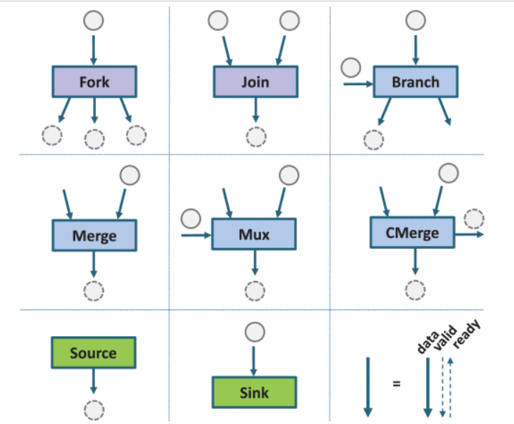
Dataflow circuits
At the circuit-level, add data/ready signals to all interfaces
Operator process (consumes) inputs only when valid and consumer is ready
We can define a set of primitives from which we built circuits
Primitives require additional circuitry
Example by Josipovic et al.
L. Josipović, A. Guerrieri and P. Ienne, "From C/C++ Code to High-Performance Dataflow Circuits“. In IEEE Transactions on Computer-Aided Design of Integrated Circuits and Systems 41(7), July 2022

Slide 14
Dataflow limitations
Fetch
What happens when we have a loop in the circuit?
E.g., register bypass in the pipeline
If EX stage needs input from MEM, first token will never be valid
Solution: Inject NULL token
Oron Port, "DFiant: A Dataflow Hardware Description Language ". Phd Thesis, Technion 2021.
Decode
Execute
Memory
Writeback

Slide 15
Case Study: TPU

Slide 16
Google TPU
In 2013 Google projected that if users use 3 minute of DNN-based voice search per day, they will need to double their data centers’ computational capacity
Started working on a hardware accelerator for NN inference
Identified that matrix multiplication is the main bottleneck
Went back to 1980s literature on systolic arrays
Deployed in 2015, published in 2017
Joupi et al., “In-Datacenter Performance Analysis of a Tensor Processing Unit”. In ISCA 2017
Recently announced the 7th generation TPU

Slide 17
Why matrix multiplication?
NNs are composed of layers of “synapses”
The inputs to each synapse are the outputs of the previous layer multiplied by a weight vector
dot_product(weights, inputs)
Synapse takes sum and applies normalization function

Slide 18
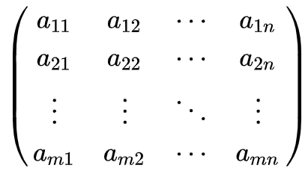
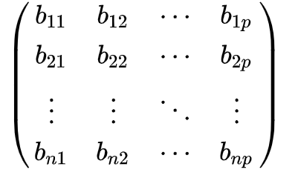
Why matrix multiplication?
In other words:
Inputs
Weights
X

Slide 19
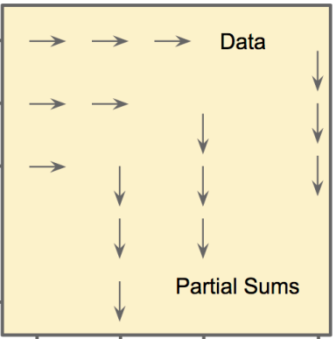
TPU’s systolic array
256x256 array of 8-bit integer MACs
Product is 16b
64k ops/cycle for 8-bit ints
Can operate at slower rate on larger formats
Reads/writes 256 values/cycles
Weights preloaded to array, and then inputs are streamed

Slide 20
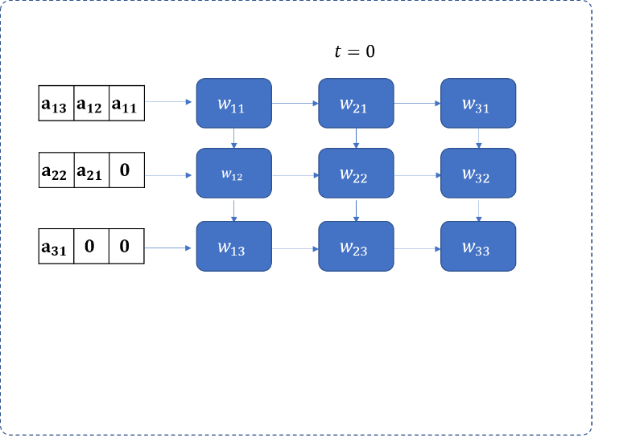
Inputs are staggered since systolic array has no control
https://telesens.co/2018/07/30/systolic-architectures/

Slide 21
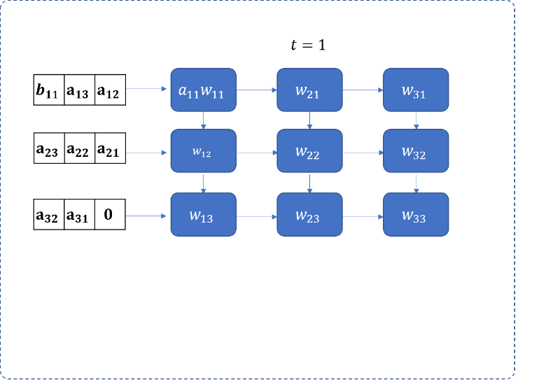
https://telesens.co/2018/07/30/systolic-architectures/

Slide 22
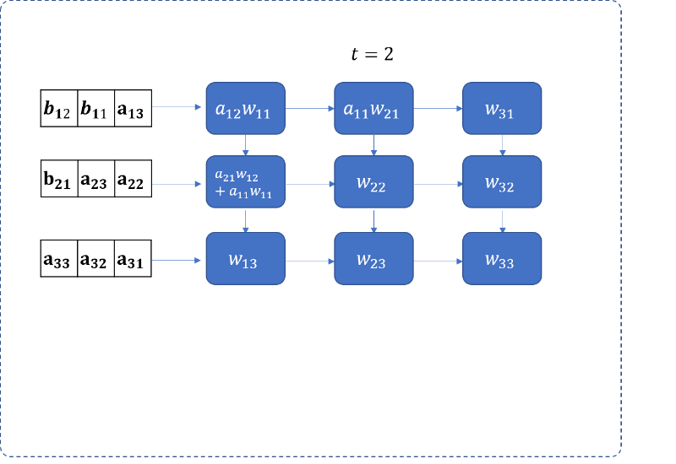
https://telesens.co/2018/07/30/systolic-architectures/

Slide 23
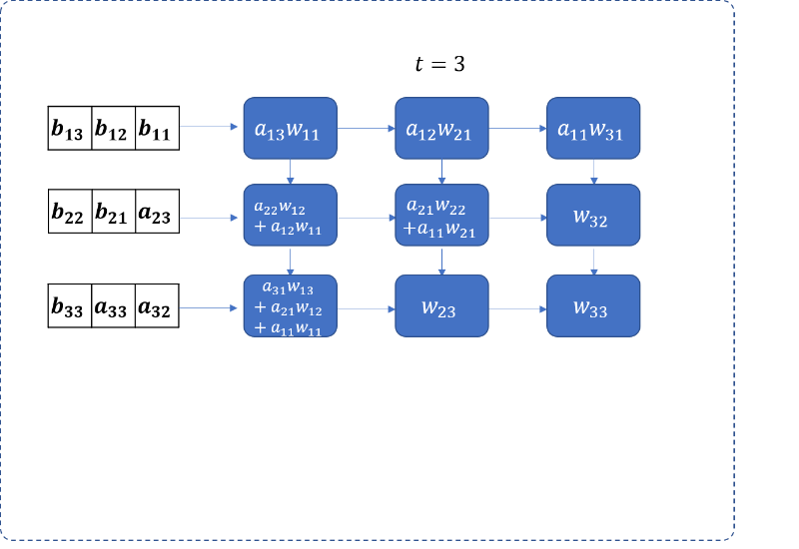
https://telesens.co/2018/07/30/systolic-architectures/

Slide 24
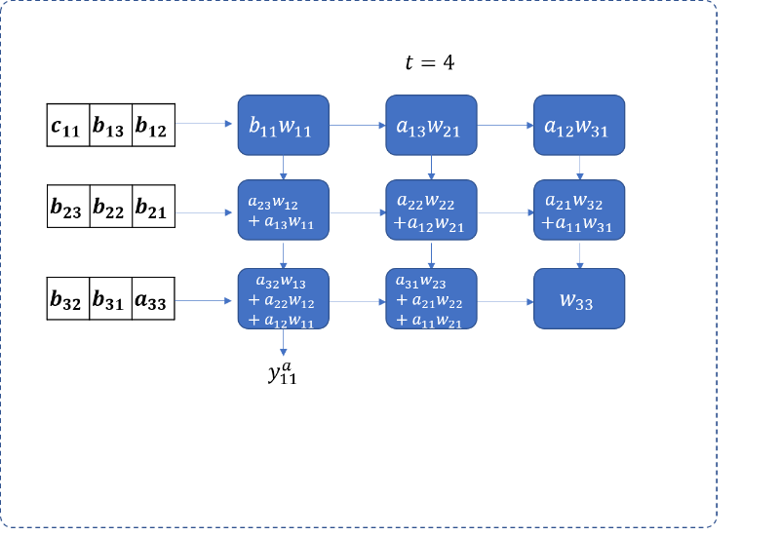
https://telesens.co/2018/07/30/systolic-architectures/

Slide 25
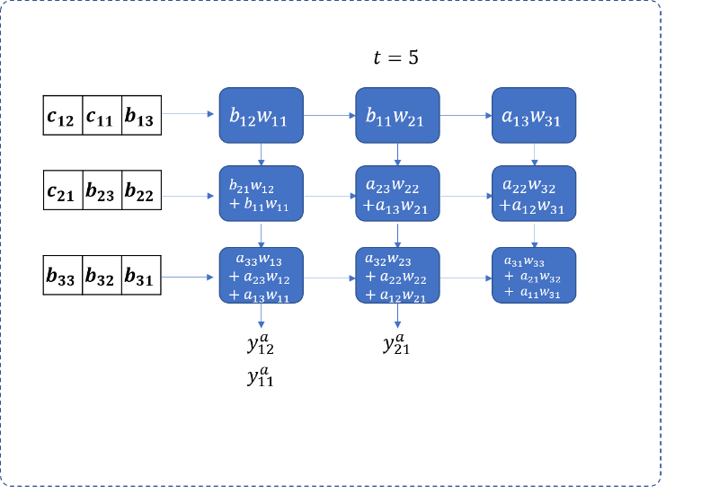
https://telesens.co/2018/07/30/systolic-architectures/

Slide 26
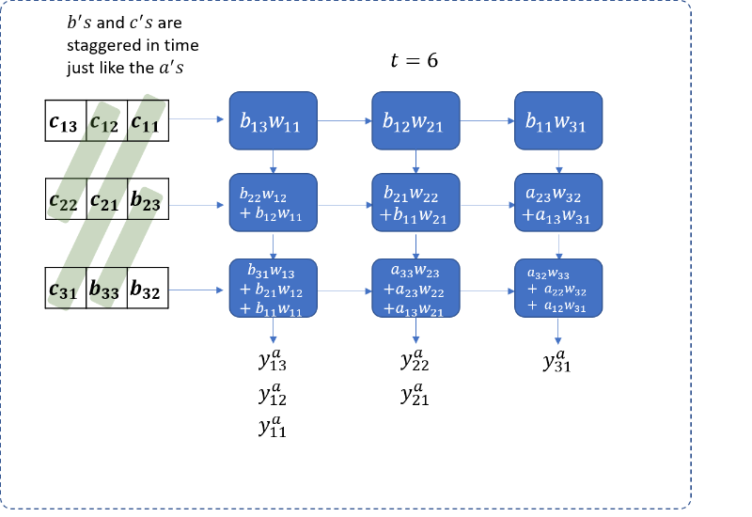
https://telesens.co/2018/07/30/systolic-architectures/

Slide 27
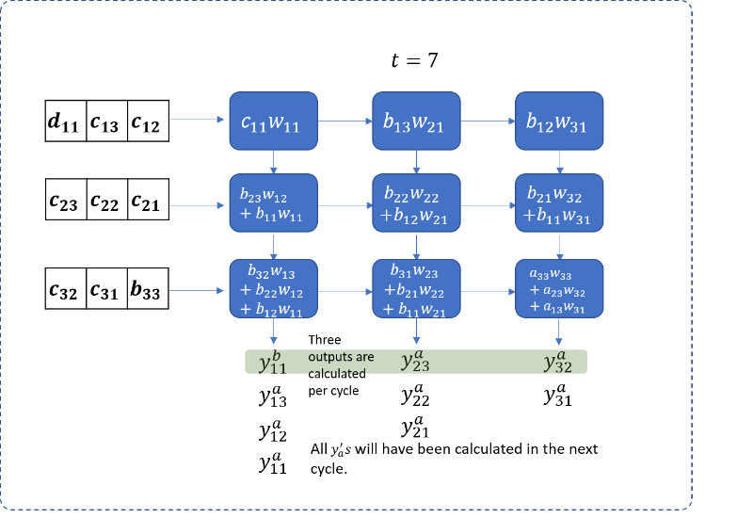
https://telesens.co/2018/07/30/systolic-architectures/

Slide 28
TPU’s systolic array limitation
A systolic array is timed only by the clock, no control
Q: What happens when the input data is not ready
A: Need to preload inputs into an on-chip staging buffer
Q: What about sparse matrices?
A: Still a major challenge; Unknown how addressed in TPUvX

Slide 29
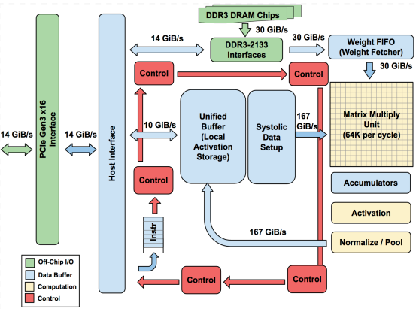
TPU block diagram
Joupi et al., In-Datacenter Performance Analysis of a Tensor Processing Unit , ISCA 2017

Slide 30
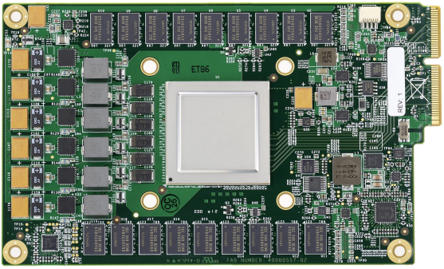
TPU gen1
PCIe gen3
32GB DRAM
384W
<331mm²
*less than ½ of Haswell
Joupi et al., In-Datacenter Performance Analysis of a Tensor Processing Unit , ISCA 2017

Slide 31
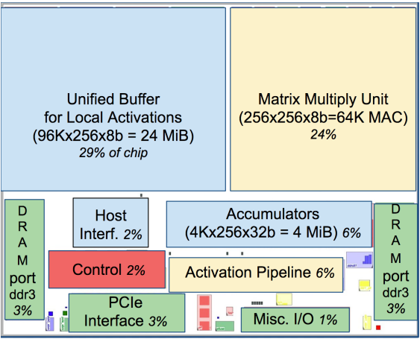
TPU: Area distribution
Joupi et al., In-Datacenter Performance Analysis of a Tensor Processing Unit , ISCA 2017

Slide 32
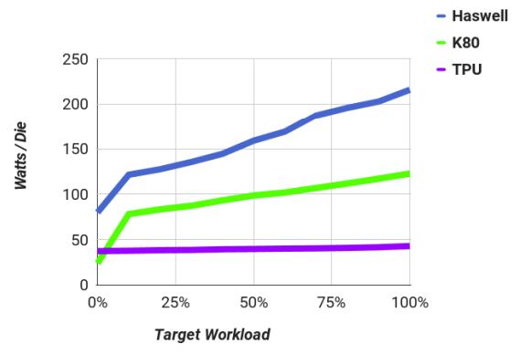
TPU: Power benefits

Slide 33
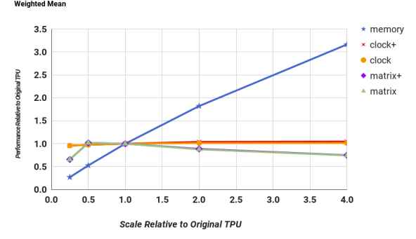
TPU: Design space exploration
Examine how scaling different parameters affect performance
Memory = memory bw
Clock+ = freq. & accums
Clock = only freq.
Matrix+ = sys. array& accums
Matrix = sys. array
Perf/TPU

Slide 34
TPU: HW/SW interface
Philosophy: TPU should behave like an external FPU
Provide ~12 commands the host can trigger
Examples listed in the paper:
Read_Host_Memory: Read data from the CPU to the unified SRAM buffer
Read_Weights: Read weights into array input FIFOs
MatrixMultiply: Trigger matrix multiplication on N inputs
Activate: apply normalization to data in accumulator memory and write to unified buffer
Write_Host_Memory: Write data from unified buffer to CPU memory

Slide 35
TPU: HW/SW interface
User-space driver controls the TPU
Reformats data
Executes TPU instructions
Use blocked matrix multiplication to split large matrices
Not clear if it is done in driver or higher up the stack (e.g., PyTorch, Tensorflow)
Users need not change their code!
Code written in high-level frameworks, e.g., PyTorch, Tensorflow

Slide 36
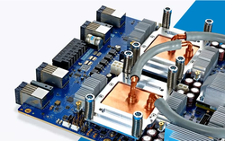
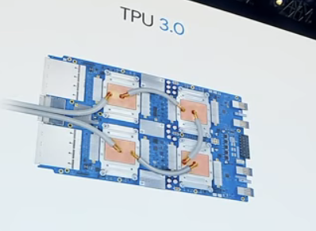
Scaling out newer generations: TPUv3
4 chips per board
Liquid cooling

Slide 37

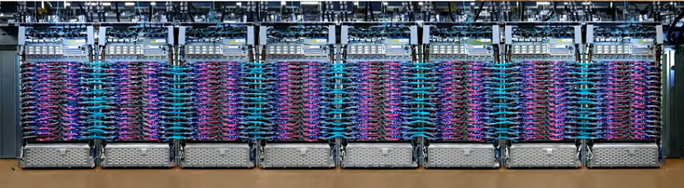
Scaling out newer generations: TPUv3
A TPU pod
3D torus network
Not clear how many sockets in a pod

Slide 38
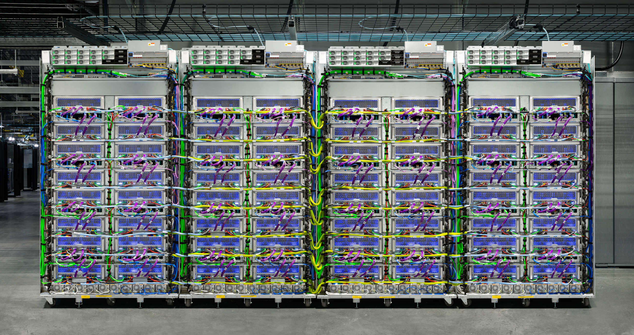
Scaling out newer generations: TPUv5
256 chips per pod
(I suspect ¼ - ½ of what we see in the image)
3D torus network

Slide 39
Case Study: APU

Slide 40
APU
Started as academic research on CGRAs in 2012
Motivation was to build a reconfigurable architecture for CUDA
Use spatial computing instead of GPU’s von Neumann core
Move data directly between functional units instead of register file
First paper published in 2014
Voitsechov and Etsion. “Single-graph multiple flows: energy efficient design alternative for GPGPUs”. In ISCA 2014
Speedata founded in late 2019

Slide 41
A dataflow CGRA
2D grid of functional units
E.g., LSU, ALU, FPU, special function units
Units are connected by a configurable network
Reconfigurable design allows mapping the computation onto the grid
LD/S
ALU
LD/S
ALU
ALU
ALU
ALU
ALU
ALU
FPU
SFU
FPU
ALU
SFU
ALU
SFU
ALU
FPU
ALU
FPU
ALU
SFU
ALU
ALU
ALU
FPU
ALU
FPU
ALU
ALU
ALU
ALU
SFU
FPU
ALU
FPU

Slide 42
A dataflow CGRA
CGRAs have been proposed in the past, e.g,:
TRIPS in 2003
Sankaralingam et al., "Exploiting ILP, TLP, and DLP with the polymorphous TRIPS architecture“. In ISCA 2003.
Tartan in 2006
Mishra et al., “Tartan: evaluating spatial computation for whole program execution”. In ASPLOS 2006
DySER in 2011
Govindaraju et al., “Dynamically Specialized Datapaths for energy efficient computing”. In HPCA 2011.
All targeted single-threaded workloads
Our take: Massively data parallel code - CUDA
LD/S
ALU
LD/S
ALU
ALU
ALU
ALU
ALU
ALU
FPU
SFU
FPU
ALU
SFU
ALU
SFU
ALU
FPU
ALU
FPU
ALU
SFU
ALU
ALU
ALU
FPU
ALU
FPU
ALU
ALU
ALU
ALU
SFU
FPU
ALU
FPU

Slide 43
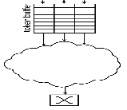
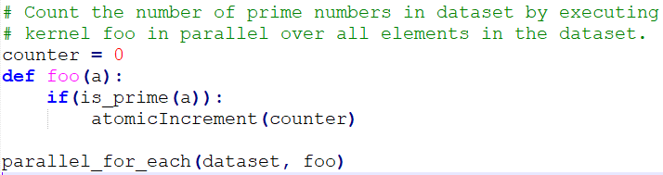
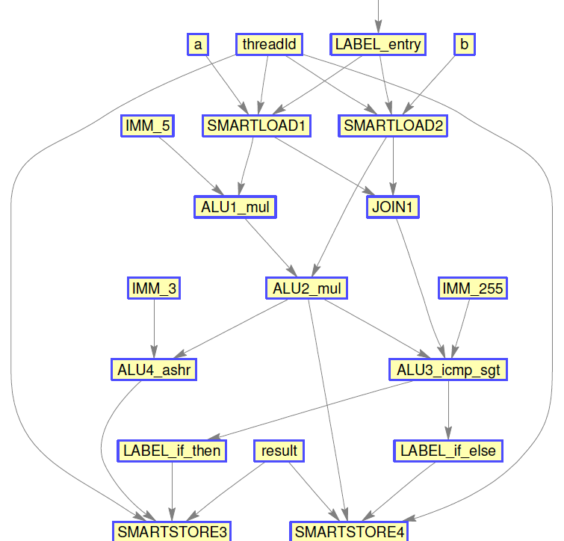
Programming the CGRA: CUDA-like parallelism
❶ Kernel/Task
❸ Map:
Compiler maps dataflow graph to CGRA and conf. network
❷
Compiler transforms kernel code to dataflow graph(s)
❹ Stream entire dataset through the configured fabric
Reconfigurable fabric

Slide 44
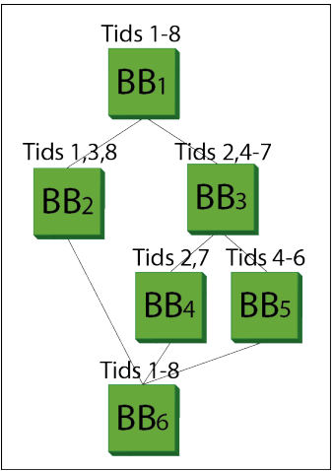
Branches
Sequential code is broken into basic blocks
Basic block: A sequence of instructions executed between branches
Different thread may have different branch outcomes
Result: Branch-divergent code

Slide 45
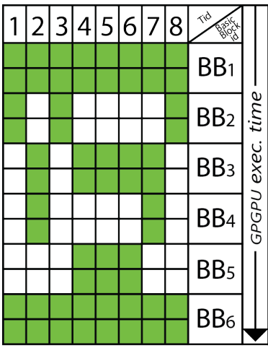
Branches: GPU
GPUs bind threads into groups (warps)
All threads in a group (warps) need to execute both ‘then’ and ‘else’ clauses
Unneeded clause is executed as nops
Breaking groups dynamically is inefficient
Result: GPUs are highly inefficient for branch-divergent code

Slide 46
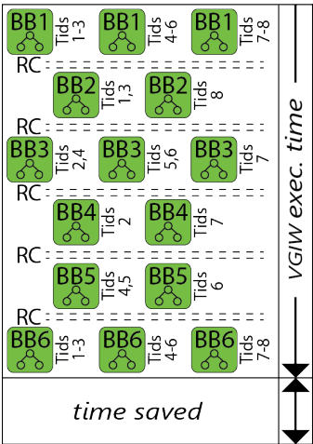
Branches: APU
Each basic block is a dataflow graph
APU runs one dataflow graph at a time
Threads and graphs are scheduled so cycles are not wasted on nops
Reconfiguration is very fast (10s of cycles)
Result: APU is very efficient even in branch-divergent code
Voitsechov and Etsion. “Control flow coalescing on a hybrid dataflow/von Neumann GPGPU”. In MICRO 2015.

Slide 47
The dataflow memory challenge
A compiler takes your code and converts it into a directed graph
Nodes are functional units
Edges are registers
What about dependencies in memory?
That’s the biggest challenge in dataflow computing

Slide 48
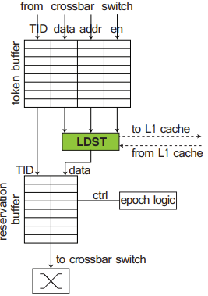
The dataflow memory challenge
Memory system allows keeping multiple accesses in-flight
Known as memory-level parallelism (MLP)
Data returned from memory in some order
Cache/memory units need to reorder returned data and stream it into the grid
Dynamic dataflow
Inside the grid, all dependencies and latencies are known
Static dataflow

Slide 49





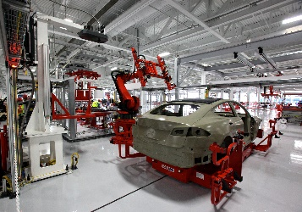

Speedata: What is data analytics and why go there?
Data is collected from many sources and ingested into storage
Sources include sensors, browsers, code agents
Data itself can be
structured (e.g., relational tables)
semi-structured (e,.g., nested relational tables)
unstructured (e.g., text, images)
Analyzed using relational operations (e.g., SQL, dataframes)
Social networks
Adtech
Manufacturing
Pharma
[credit for copyrighted images goes to respective companies]

Slide 50
Mapping SQL to multiple CGRAs in the APU Filter + JOIN + GROUPBY by example
Field manipulation
Example: SUM(IF(name= ‘Tom’ OR name=‘Scott’))
On-chip NoC + memory banks
1.6Tbps
Record
LD/S
ALU
LD/S
ALU
LD/S
ALU
LD/S
ALU
Record
Encode
Compress
Decompress
Decode
Process
ALU
ALU
ALU
ALU
ALU
ALU
ALU
ALU
Decompress
Decode
Process
Encode
Compress
ALU
FPU
SFU
FPU
ALU
FPU
SFU
FPU
ALU
SFU
ALU
SFU
ALU
SFU
ALU
SFU
ALU
FPU
ALU
FPU
ALU
FPU
ALU
FPU
ALU
SFU
ALU
ALU
ALU
SFU
ALU
ALU
ALU
FPU
ALU
FPU
ALU
FPU
ALU
FPU
ALU
ALU
ALU
ALU
ALU
ALU
ALU
ALU
Decompress
Decode
Process
SFU
FPU
ALU
FPU
SFU
FPU
ALU
FPU
Encode
Compress
Filter records
JOIN
GROUPBY
Data flow
Notes:
Minimize number of trips to memory

Slide 51
APU: HW/SW interface
We do not expose the interface, but it is hidden from the users
End users write SQL or dataframe queries
We plug into existing analytics framework to offload computation into the APU
Users need not change their code!

Slide 52


Integration with software ecosystem
Worker-1
SPEEDATA
Parser
Logical Plan
Physical Plan
X86/JVM Code Generator
bin
Scheduler
Plugin
Worker-2
SQL Query
Dataframes
Pandas
APU Code Generation
bin
Worker-3
Speedata query compiler
Coordinator Node Software
Worker-4
SPEEDATA
Operators that are not supported yet are redirected to x86
Rule #3…
Worker-N

Slide 53
Summary
A key challenge in HW/SW co-design: Don’t break user code!
Dominant accelerator design paradigms:
Systolic arrays (for matrix multiplication)
Coarse-grain reconfigurable arrays (CGRA)
And the general dataflow model
Two case studies:
Google TPU: Catapulted Google’s AI efforts
Speedata APU: Commercial CGRA for data analytics

Slide 54
Thank you Questions?

